Slide 1

Goal setting
Manual to success
„If you don’t know where you are going, every road will get you nowhere.” Kissinger
METU: 2025

Slide 2

Why we are here today?
„We did not come to fear the future. We came here to shape it.”
BARACK OBAMA

Slide 3
Evaluation of the training:
Active participation on the training day.
Prepare home work: detailed individual goal setting based on the information gathered today (use as much technique learnt as much as you could).
Deadline: at the end of 7th day from the training
Mandatory reading:
John C. Maxwell: Success
Proposed reading:
Carol S. Dweck: Mindset: The New Psychology of Success

Slide 4
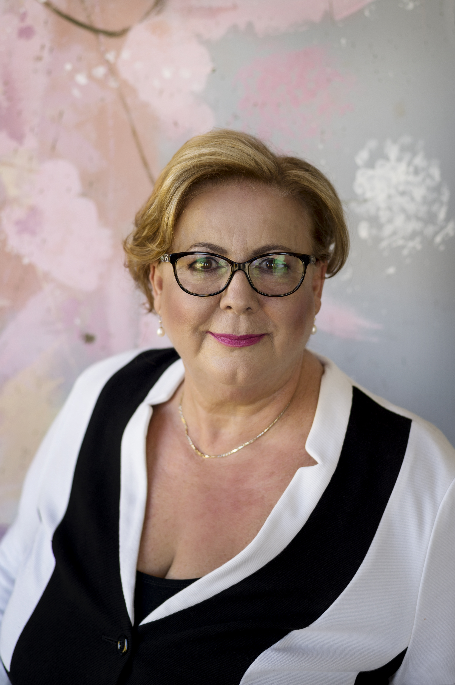
Introduction
Edit Sziráki
Executive Coach
30 years professional experiences, of which 20 years as top manager in banking.
I love people, animals, literature and music.
Phone:
06 30 793 0293
Email:
edit.sziraki@szirakicoaching.hu

Slide 5

Reasoning
Goals affect performance by directing attention, mobilizing efforts, increasing persistence, and motivating strategy development.
Goal-setting is an essential tool for self-motivation and self-drivenness; both at personal and professional levels.
Goal-setters are capable to see future possibilities and the big picture.
Setting goals are linked with higher motivation, self-confidence and researches have established a strong connection between goal-setting and success (Locke & Latham, 2006, Matthews,2015)
Specific and challenging goals led to higher performance than easy goals („do your best goals” or „no goals”).

Slide 6

1. exercise: Who am I? Sometimes later becomes never. Do it now.
This Photo by Unknown Author is licensed under CC BY-SA-NC

Slide 7

2. exercise: Planning
You are working in 3 teams.
Appoint a speaker.
You have 10 minutes!
Plenary discussion.
Task: create a plan for building a tower. Only A4 paper sheets could be used.
1.team: it should as high as it is possible.
2.team: the priority is the safety, but it should be also high,
3. team: you could do what ever you want but build something from A4 sheets.

Slide 8
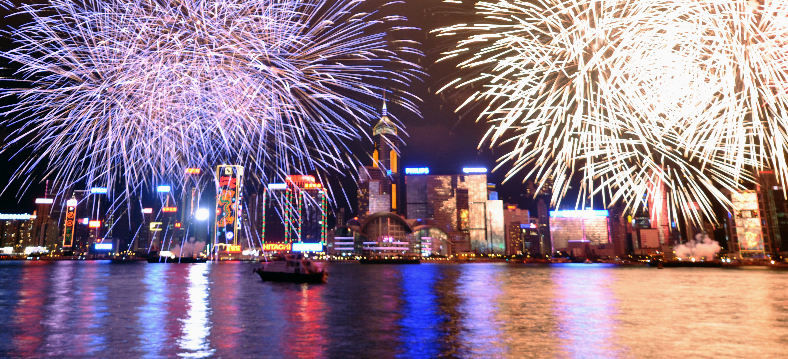
Most well-known, common goals?

Slide 9
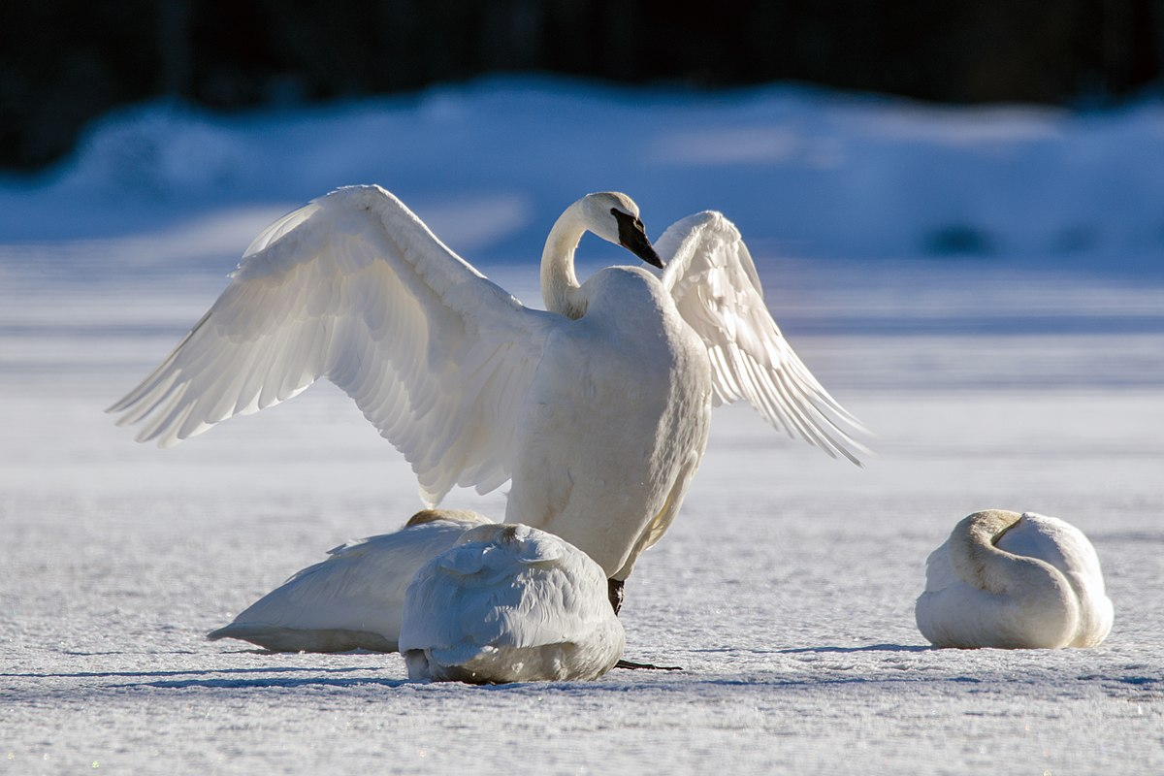
3. task: The dying swan
Only 8% of New Year Resolutions come true !
What do you think why?
What are the reasons?
3 teams
Discuss and write it down, present to the others.
10 minutes

Slide 10
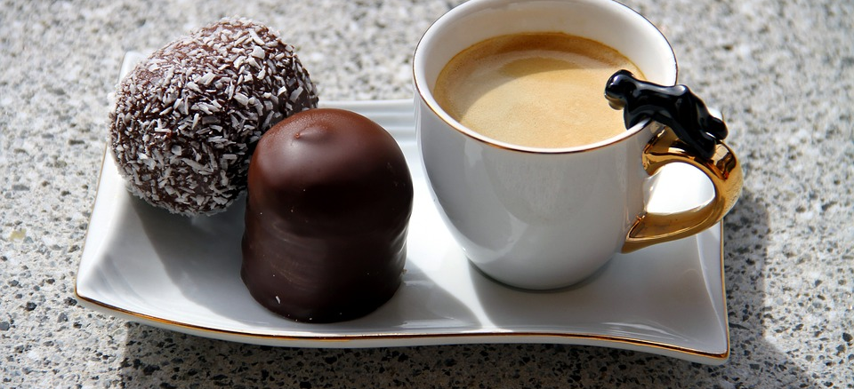
Brake! 20 minutes (exactly)

Slide 11

SMART goal setting system
SPECIFIC
MEASURABLE
ATTAINABLE
RELEVANT
TIME-BOUND

Slide 12
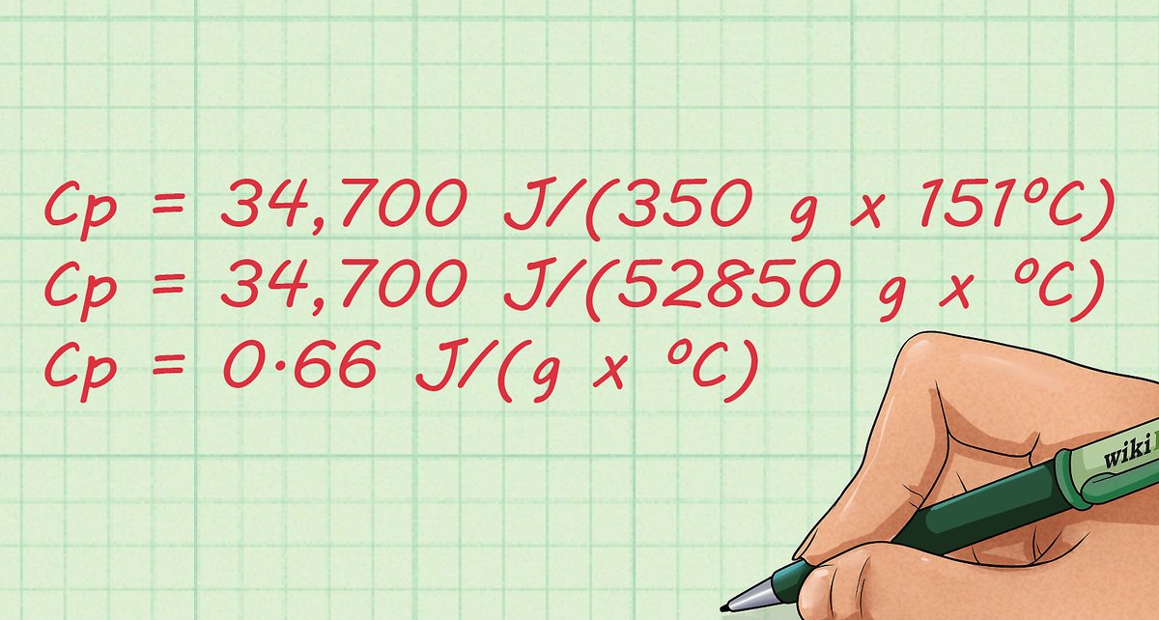
SMART: Specific
What? What needs to be accomplished?
Who? Who’s responsible for it?
I’d like to be a successful marketing specialist.
I’d like to be a successful marketing specialist, working for a multinational company which is taking care of sustainable growth.
I’d like to be a successful online marketing specialist, working for a multinational company (which is taking care of sustainable growth) as a lead manager, with xyz yearly earning.
I’d like to be a successful online marketing specialist, working for a multinational company (which taking care of sustainable growth) as a lead manager, with xyz yearly earning and getting the yearly award of Marketing Association before my 40s.

Slide 13

SMART: Measurable
How far? How much?
Measure the progress and improvement.

Slide 14
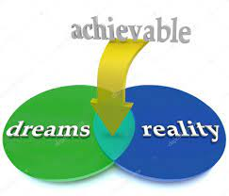

SMART: Attainable/Achievable How? Plan?

Slide 15

SMART: Relevant
Why? Importance to me?

Slide 16
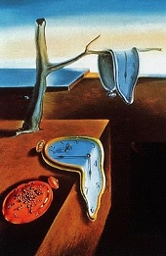
SMART: Time-bound
When?
Not necessarily an exact date.
This Photo by Unknown Author is licensed under CC BY-NC-ND

Slide 17
3/a task: The Swan
Choose a typical New Year Resolution and transform it into the SMART criteria system.
3 teams

Slide 18
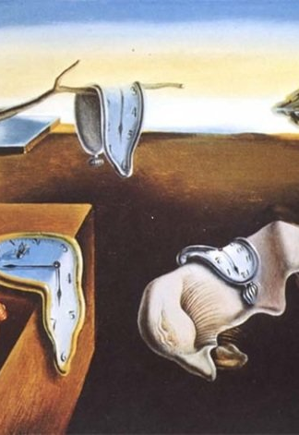
4. task: Time management
Individual task:
As a first step everybody put together his/her agenda, list 8-10 most important activity (which takes 30 minutes at least.) How long does it take each of them? (take a general week as a basis).
Second step: set priority order.
Third step: choose at least one which you could have cancel, to be able to do something more important e.g.: working on your future targets. Cancellation could happen only temporary basis as well.
Fourth step: select those activities you could do within shorter time, wright down the minutes saved.
How much could have been your time savings?

Slide 19

Lunch! 1 hour (exactly)
This Photo by Unknown Author is licensed under CC BY-ND

Slide 20

Some Golden Rules
Goals should be: motivating, uplifting, positive.
You should have long terms targets, have dreams.
Baby steps; set small, short term goals as well.
Have a plan and write it down. "A goal without a plan is just a wish." Antoine de Saint-Exupéry.
Share it with others.
Be engaged!
Failure is your friend.
10 times rule.
SMART goal setting system.
„ Sometimes we believe that we know what happening with us.
But it turns out that somebody changed the transcript. ”
Barney Stinson

Slide 21
Critical points
Pitfalls:
Control your progress or development.
Have more than one, but not much target.
Publish, share your aims.
Set a priority order.
Collect supporters, ask for help if it is needed.
Celebrate your achievements.
Have a role model.

Slide 22

Critical points
Focus vs flexibility
Inspiration vs stress
Challenge vs impossibility
Success vs failure
Procrastination
Self - recognition
Golden Circle: motivation for ever?

Slide 23

Ask for help, seek for supporters!

Slide 24

Celebrate!

Slide 25
Brake! 20 minutes (exactly)

Slide 26

Our strongest supporter is our brain!
What is RAS and what kind of role does it have in our successes?
What is neuro agility?
Routines. Are they success factors?
The power of words
Importance of exercises

Slide 27
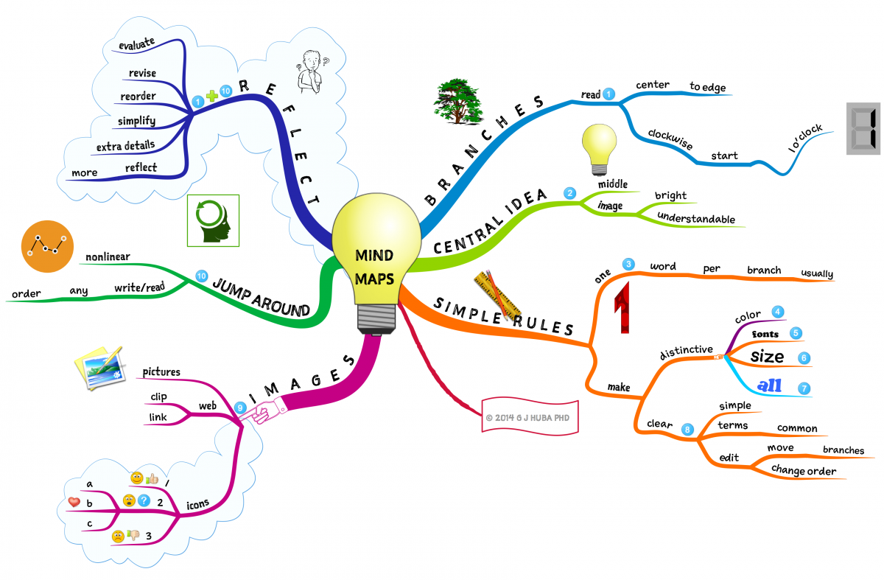
8. task: Mindmapping1
Fears related to goal setting and success.
This Photo by Unknown Author is licensed under CC BY-ND

Slide 28
Brake! 10 minutes (exactly)

Slide 29
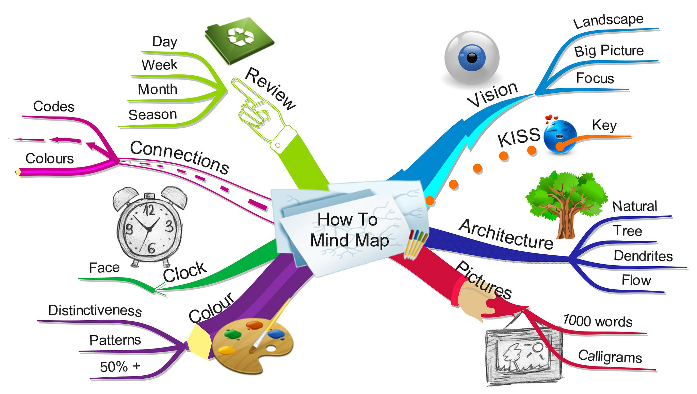
9. task: Mindmapping2
Positive factors, resources, competencies related to goal setting and success.
Could your fears be neutralised with your positive factors?
This Photo by Unknown Author is licensed under CC BY-NC-ND

Slide 30

Famous failures

Slide 31

Closing

